Slide 1
REAL-TIME RESEARCH PROJECT

Slide 2
Title :
IoT Based Occupancy Monitoring Techniques for Energy Efficient Smart Buildings
GUIDE:
M.MADHUSUDHAN
PRESENTED BY:
BATCH-7 K.SANTHOSHI
P.KRANTHESH
M.ANAS

Slide 3
INTRODUCTION
Smart buildings aim to optimize energy usage and improve comfort using advanced technologies. IoT-based occupancy monitoring systems detect the presence of people in rooms or buildings using sensors such as PIR sensors, cameras, Wi-Fi tracking, and CO2 sensors. These systems help automate lighting, HVAC, and other building systems to reduce unnecessary energy consumption and improve efficiency.

Slide 4
EXISTING SYSTEM
Traditional energy management systems rely on manual switching or fixed schedules for lighting and HVAC. These systems do not consider real-time occupancy and often lead to energy wastage when rooms are empty. They also lack automation, scalability, and intelligent monitoring capabilities.

Slide 5
PROBLEMS IN EXISTING SYSTEM
• High energy consumption due to lack of occupancy awareness.
• Manual control of lighting and appliances.
• Inefficient HVAC operation.
• Lack of real-time monitoring and data analytics.
• Increased operational costs in buildings.

Slide 6
PROPOSED SYSTEM
The proposed system uses IoT sensors to monitor occupancy in real time. Sensors collect data about human presence and send it to a central IoT platform or cloud server. Based on the occupancy data, the system automatically controls lighting, ventilation, and air conditioning systems to optimize energy usage. Data analytics helps building managers understand usage patterns and improve efficiency.

Slide 7
ADVANTAGES
• Reduces energy consumption significantly.
• Automatic control of lighting and HVAC systems.
• Real-time monitoring of room occupancy.
• Improves comfort and convenience for occupants.
• Supports smart building automation.

Slide 8
SYSTEM REQUIREMENTS
HARDWARE REQUIREMENTS:
• System: Pentium Dual Core or above
• Sensors: PIR Sensor / Camera / Temperature Sensor
• Microcontroller: Arduino / Raspberry Pi
• RAM: 2 GB or above
• Internet Connectivity
SOFTWARE REQUIREMENTS:
• Operating System: Windows 10/11
• Programming Language: Python
• Tools: Arduino IDE / VS Code
• Cloud Platform: IoT Cloud / Firebase

Slide 9
NOVELTY OF THE PROJECT
• Integrates IoT sensors for accurate occupancy detection.
• Uses real-time data to control energy systems.
• Enables smart automation in buildings.
• Provides analytics for energy optimization.
• Reduces carbon footprint and operational costs.

Slide 10
SYSTEM ARCHITECTURE
Steps:
1. Occupancy Detection using Sensors
2. Data Collection by IoT Devices
3. Data Transmission to Cloud Server
4. Data Processing and Decision Making
5. Automatic Control of Lights and HVAC
6. Energy Usage Monitoring Dashboard

Slide 11
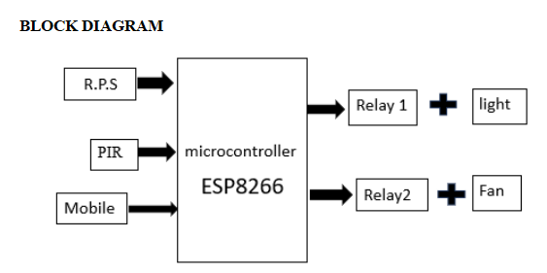

Slide 12
MODULES
1. Sensor Module
2. Data Collection Module
3. IoT Communication Module
4. Data Processing Module
5. Energy Control Module

Slide 13
UML DIAGRAM
Unified Modeling Language (UML) diagrams visually represent the system design and functionality.
Includes:
• Case Diagram
• Class Diagram
• Sequence Diagram
• Activity Diagram

Slide 14
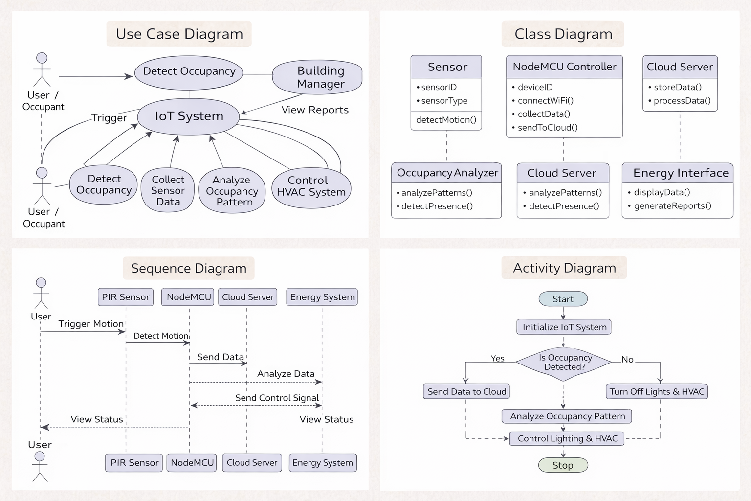
UML DIAGRAM

Slide 15
CONCLUSION
IoT-based occupancy monitoring systems help improve energy efficiency in smart buildings by automatically controlling lighting and HVAC systems based on real-time occupancy data. The proposed system reduces energy waste, lowers operational costs, and contributes to sustainable and intelligent building management.

Slide 16
THANK YOU

